Slide 1
Object Oriented Programming

Slide 2
Outline
What is OOP?
Encapsulation
Abstraction
Inheritance
Polymorphism

Slide 3
What is OOP?
Using objects to create a tangible model of a collection of objects that interact with each other to achieve our programs goals.
OOP can often be considered a programming paradigm that attempts to simulate a real-world model that is easy to understand.
Objects
Attributes – Fields
Stuff the program knows
Behaviors – Methods
Stuff the program can do with the stuff the program knows

Slide 4
Encapsulation
The process of organizing your code on a need-to-know basis.
Prevent other objects from changing an object’s state by making it’s attributes private.
A Dog class might have attributes:
Hunger, Thirst, and Mood
The Human class should not be able to directly modify these values, but instead have a way to modify them through the Dog’s behavior.
Feed(), Water(), Play()

Slide 5
Encapsulation
You write a program that creates a Graph class. The Graph class needs to create Nodes and Edges to complete itself.
Your main program, or more specifically, anything that isn’t the Graph class has absolutely no reason to know anything about Nodes and Edges.
Instead, your main program can run a behavior on the Graph class to interact with the Nodes and Edges.
The reason for this, is that a Node by itself is worthless! It needs to be encapsulated within the Graph class to be of any use.

Slide 6
Abstraction
Abstraction is the act of representing essential features without including the background details or explanations.
In the computer science and software engineering domain, the abstraction principle is used to reduce complexity and allow efficient design and implementation of complex software systems.

Slide 7
Abstraction
Simply put, abstraction simplifies your projects and makes them easier to work with and understand. Managing a very large solution with very little abstraction is very difficult.
Abstraction means that each object should only expose a high-level mechanism for using it.
Example: Mobile Phone
What happens under the hood?
You don’t need to know because you are given an interface and some buttons to utilize.
Abstraction makes using a complex object simple.

Slide 8
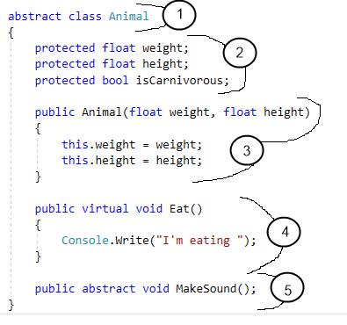
An Abstract Class
We declare the class “abstract
Note, we cannot create an instance of an animal (IE, no “new Animal()”)
Animal fields
Note “protected” before the variables.
Animal constructor
Note how we don’t set “isCarnivorous”.
Virtual method
A similarity between every animal
Abstract method
A difference between every animal

Slide 9
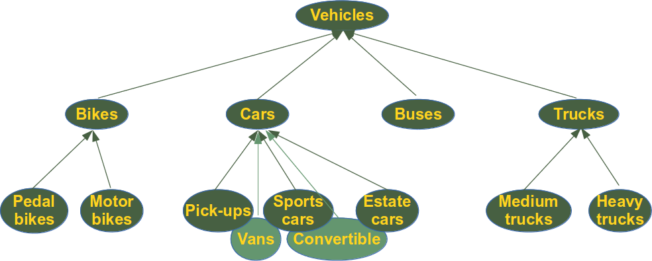
Inheritance
Inheritance is a feature that represents the “is a” relationship between different classes.
Inheritance allows a class to have the same behavior as another class and extend or tailor that behavior to provide special action for specific needs.

Slide 10
Inheritance
When writing object oriented programs, you will find that many of your objects are often very similar.
Two objects might share common attributes or behaviors, but the two objects behave just differently enough that you can’t use the same class to create them.
With inheritance, we can create multiple child classes that derive from a parent class.
The parent class implements all of the common elements.
The child classes implements all of the unique elements.
Inheritance simplifies complex data structures by having them share common elements.

Slide 11
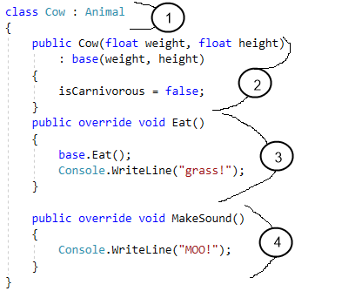
An Inherited Class
Cow inherits from Animal
The Cow class’s constructor
Note, we add “: base(params)” to additionally call the Animal constructor.
Animal.Eat() is a virtual method.
Therefore we call “base.Eat()”.
Animal.MakeSound() is abstract.
Therefore we MUST implement it.

Slide 12
Polymorphism
Polymorphism means, “Many shapes” in Greek.
It allows us to consider some object types as if they were a different type.

Slide 13
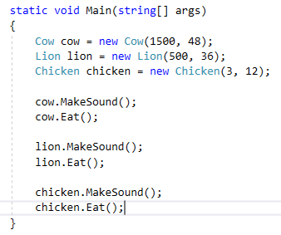
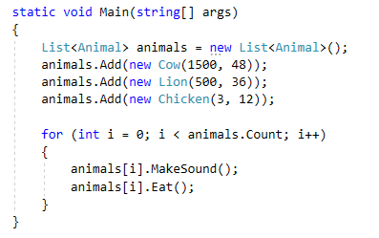
Abstraction, Inheritance, & Polymorphism
VS

